Slide 1
Hadoop MapReduce
How to Survive Out-of-Memory Errors
The International Summer Undergraduate Research Fellowship
Member: Yoonseung Choi
Soyeong Park
Faculty Mentor: Prof. Harry Xu Student Mentor: Khanh Nguyen
Notes:
Hello, everyone.
My name is Soyeong Park.
First, thank you for coming our I-SURF presentation.
Today, I will talk about Hadoop MapReduce.
In detail, Today's topic is 'how to survive out-of-memory errors'.
Prior to the beginning, Let me introduce my team.
My team is made up Yoonseung and me as I-SURF student, Khanh as student mentor, Prof. Harry Xu as faculty mentor.

Slide 2
Outline
Introduction
What is MapReduce?
How does MapReduce work?
Limitations of MapReduce
What is our goals?
Operation test
Conclusion
Notes:
As you can see, our presentation consists of seven categories.
I will address one to five categories, and yoonseung will address the rest categories.
So if you have any questions, please hold your questions until the end of our presentation.

Slide 3
“There was 5 exabytes of information created between the dawn of civilization through 2003,
But that much information is now created
every 2 days, and the pace is increasing...”
- Eric Schmidt, Google CEO
Notes:
Before the speech, I want to say Eric Schmidt as Google CEO's famous saying due to relate our topic.
He said, " ~~~ ".
Exabytes mean one billion gigabytes.
So to speak again, it means very big size of data.
Through Eric Schmidt's saying, we can know our generation now enters the era of Big data, and datasets are growing rapidly than we think.

Slide 4
Data scientists want
to analyze these
large data sets
How can we handle that?
Distribute processing
But single machines
have
limitations
in processing
these data sets
Do we need to
understand
the details of
parallelization,
fault tolerance,
data distribution
and load balancing?
parallelization
fault tolerance
data distribution
load balancing
Furthermore, data sets
are now growing very rapidly
The answer is ‘no’
Notes:
For the reasons, many people want to analyze these large data set.
But a single machines have lots of limitations.
And data sets are growing rapidly than we think.
So we can ask a question such as "How can we handle that?"
The answer is using distribute processing is suitable.
Distributed processing means a method for processing a single application using at least two machines.
Generally, many people think that it needed to understand to lots of professional knowledge such as fault tolerance, data distribution, and so on.
But it is actually not.

Slide 5

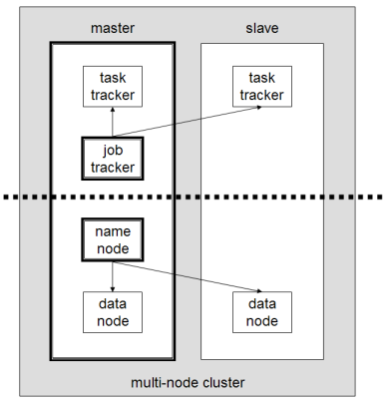
MapReduce is a programming model for processing and generating large data sets
Many real world tasks are expressible in this model
MapReduce Layer
HDFS Layer
The model is easy to use, even for programmers without experience with parallel and distributed systems
* https://en.wikipedia.org/wiki/Apache_Hadoop
[1] Jeffrey Dean and Sanjay Ghemawat. (2004). “MapReduce: Simplified Data Processing on Large Clusters”.
Notes:
So to process large data sets, we can use Hadoop MapReduce. MapReduce is one of the mainly used programming model for Big-data.
And it aims to use easily for programmers without experience with lots of professional knowledge such as fault tolerance, and so on.

Slide 6
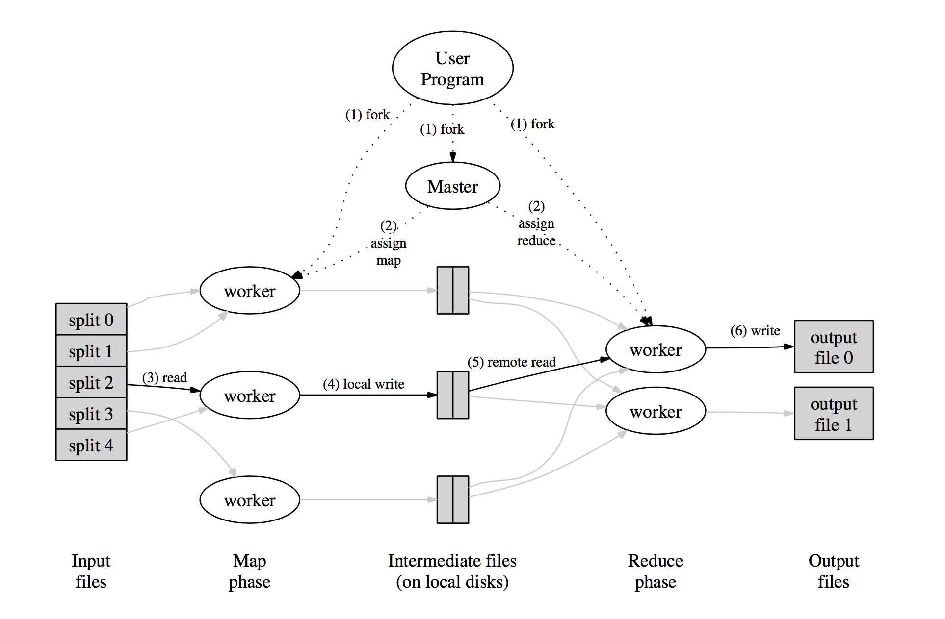
What is MapReduce?
Mapper takes an input
and produces a set
of intermediate
key/value pairs
Reducer merges together
these intermediate values
associated with the same
intermediate key
[1] Jeffrey Dean and Sanjay Ghemawat. (2004). “MapReduce: Simplified Data Processing on Large Clusters”. p.12
Notes:
As you can see, this picture is MapReduce's workflow.
As we know from the name of 'MapReduce', MapReduce is combination of the word 'Map' and 'Reduce'.
And 'Mapper' means the map task worker, 'Reducer' means the reduce task worker.
The MapReduce workflow has two steps.
First, the Mapper takes an input.
And then it emits intermediated key/value pairs.
Second, Reducer takes these information.
And it merges together these intermediate key/value pair associated with the same intermediate key.
Finally, Reducer makes an output file to read easily for human.

Slide 7
How does MapReduce work?
The cat sees the dog, and the dog sees the cat.
The cat sees the dog
cat, 1
Reduce
Phase
dog, 1
sees, 1
and, 1
Map Phase
the, 2
cat, 2
dog, 2
and, 1
sees, 2
And the dog sees the cat
cat, 1
the, 4
dog, 1
sees, 1
- wordcount program
- A sentence is split
into two map tasks
the, 2
Notes:
To elaborate more detail, I address using an example that use an WordCount program and two map tasks and one reduce task.
As you can see, one sentence is handled by this process.
First, input sentence is split into the number of map tasks.
In this example, we use two map tasks.
So input sentence is split two sentences.
Second, each mapper produces a set of key/value pairs.
This field is key, and this field is value.
we call them intermediate key/value pairs.
Third, reducer takes intermediate key-value data and merges them.
And then we can look the result of this MapReduce process through output file made by Reducer.

Slide 8
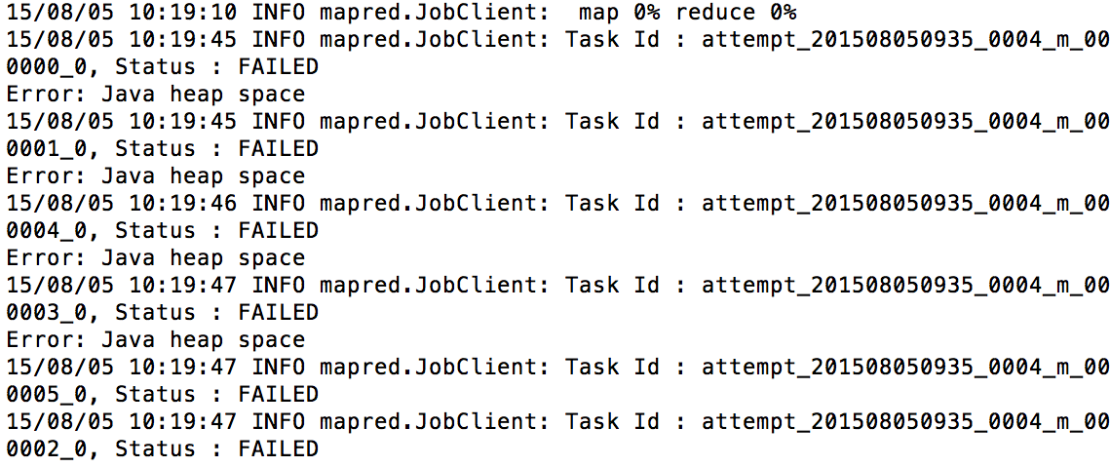
Limitations of MapReduce
Out-of-Memory Errors
High Memory Pressure
Inappropriate Configuration
There are many reasons for poor performance
And even experts sometimes can’t figure them out
Notes:
But MapReduce has limitations.
There are many reasons for poor performance such as Out-of-Memory, high memory pressure, and so on.
For example, as you can see, the red line in this picture means Out-of-Memory.
So our project aims to survive these limitations.

Slide 9
What is our goals?
Research Out-of-Memory Error cases
OOM cases documentation
Implement and simulate StackOverflow OOM cases
Develop solutions for such OOM cases
… all done!!
Notes:
To accomplish our project during 10 weeks, we set four targets.
First, "~~~". Second, "~~~". Third, " ~~~~". Fourth, " ~~~~"
In first and second, we analyzed and categorized Out-of-Memory cases.
In third, we implemented simple codes and tested several conditions adjusting configuration parameters.
In fourth, we actually solved and tested Out-of-Memory cases in StackOverFlow.
Currently, we completely executed this four targets.
From now on, Yoonseung will address the result of Out-of-Memory and the result of our project and so on.

Slide 10
Two Categories
Inappropriate Configuration Configuration which causes poor performance
Large Intermediate Results Temporary data structure grows too large
[3] Lijie Xu, “An Empirical study on real-world OOM cases in MapReduce jobs, Chinese Academy of Sciences.
Notes:
We research some papers, and there’re some patterns which make an OOM. And we can categorize this patterns into 3 categories.

Slide 11
1. Inappropriate Configuration
Operation test environments
Standalone & Pseudo-distributed mode - ‘14 MacBook Pro, 2.8 GHz Intel Core i5 8GB 1600 MHz DDR3, 500GB HDD - ‘12 MacBook Air 1.4, GHz Intel Core i5 4GB 1600 MHz DDR3, 256GB HDD
Fully-distributed mode - Raspberry Pi 2 Model B (3 nodes) A quad-core ARM Cortex-A7 CPU (1Ghz Overclock) 1GB 500MHz SDRAM, 64GB HDD, 100Mbps Ethernet

Slide 12
Split size variation [Single node]
Input: StackOverflow’s users profiles (1GB)
Test program: Standard deviation of users’ age
Running time(sec)
Split size
(MB)
* ‘14 MacBook Pro 2.8, GHz Intel Core i5, 8GB 1600 MHz DDR3, 500GB HDD
Notes:
Show just running time decrease

Slide 13
Split size variation [Single node]
Input: StackOverflow’s users profiles (1GB)
Test program: Distributed grep with no Reduce function
Running time(sec)
Split size
(MB)
* ‘14 MacBook Pro 2.8, GHz Intel Core i5, 8GB 1600 MHz DDR3, 500GB HDD
Notes:
Show just running time decrease

Slide 14
Split size variation [Single node]
Input: StackOverflow’s Comments (8.5GB)
Test program: Standard deviation of comment’s text length
Running time(sec)
Split size
(MB)
* ‘12 MacBook Air 1.4, GHz Intel Core i5, 4GB 1600 MHz DDR3, 256GB HDD
Notes:
Show just running time decrease

Slide 15
Split size variation [Single node]
Input: StackOverflow’s Comments (8.5GB)
Test program: Count Min and Max value
Running time(sec)
Split size
(MB)
* ‘12 MacBook Air 1.4, GHz Intel Core i5, 4GB 1600 MHz DDR3, 256GB HDD
Notes:
Show just running time decrease

Slide 16


Split size variation [Fully-distributed]
Input: StackOverflow’s users profiles (1GB)
Test program: average users’ age based on countries
Running time(sec)
Split size
(MB)
* Raspberry Pi 2 Model B (3 nodes) A quad-core ARM Cortex-A7 CPU (1Ghz Overclock) 1GB 500MHz SDRAM, 64GB HDD, 100Mbps Ethernet
800MHz (6M6R) | 32MB | 64MB | 128MB | 256MB
1st | 8m28s | 8m32s | 10m0s | 12m46s
2nd | 8m35s | 8m44s | 9m58s | 12m14s
3rd | 8m33s | 8m59s | 10m13s | 13m38s
Avg. | 8m32s | 8m45s | 10m4s | 12m53s
[master]
[worker1]
100Mbps
Ethernet
[worker2]
Notes:
Why graph grows?
Because 256 split size has just 4 map tasks
It means 2 of 6 mapper will not work.
So we need more bigger

Slide 17
Split size variation [Fully-distributed]
Input: StackOverflow’s users profiles (1GB)
Test program: Distributed grep with no Reduce function
Running time(sec)
Split size
(MB)
* Raspberry Pi 2 Model B (3 nodes) A quad-core ARM Cortex-A7 CPU (1Ghz Overclock) 1GB 500MHz SDRAM, 64GB HDD, 100Mbps Ethernet
800MHz (6M6R) | 32MB | 64MB | 128MB | 256MB
1st | 8m28s | 8m32s | 10m0s | 12m46s
2nd | 8m35s | 8m44s | 9m58s | 12m14s
3rd | 8m33s | 8m59s | 10m13s | 13m38s
Avg. | 8m32s | 8m45s | 10m4s | 12m53s
[master]
[worker1]
100Mbps
Ethernet
[worker2]
Notes:
Why graph grows?
Because 256 split size has just 4 map tasks
It means 2 of 6 mapper will not work.
So we need more bigger

Slide 18
io.sort.mb variation [Single node]
Input: StackOverflow’s Comments (8.5GB)
Test program: Standard deviation of comment’s text length
Running time(sec)
Io.sort.mb
(MB)
* ‘12 MacBook Air 1.4, GHz Intel Core i5, 4GB 1600 MHz DDR3, 256GB HDD
Notes:
Factor value 가 io.sort.mb의 1/10임을 말로 설명
Show just running time decrease

Slide 19
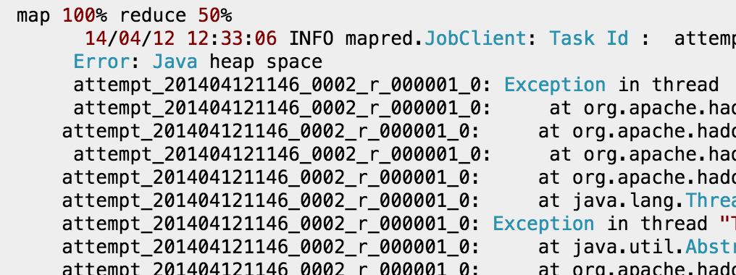
2. Large Intermediate Results
… working well with small datasets like 200-500MB. But for datasets above 1GB, I am getting an error like this:
* http://stackoverflow.com/questions/23042829/getting-java-heap-space-error-while-running-a-mapreduce-code-for-large-dataset

Slide 20
Investigation of Problem
The Mapper
Task 1
[K, V]
Task 2
1.3
GB
[K, V]
Task 3
Task 4
[K, V]
4.8
GB
Task 5
Intermediate
Key/value pairs
[K, V]
JAVA HEAP SPACE
Splited
Input files
almost
1 GB
[K, V]

Slide 21
Investigation of Problem
The Reducer
[K, V]
I just have
1GB Heap
Space!
[K, V]
[K, V]
4.8
GB
Intermediate
Key/value pairs
[K, V]
JAVA HEAP SPACE
almost
1 GB
[K, V]
almost
1 GB
Java heap can’t contain
Intermediate data structure

Slide 22
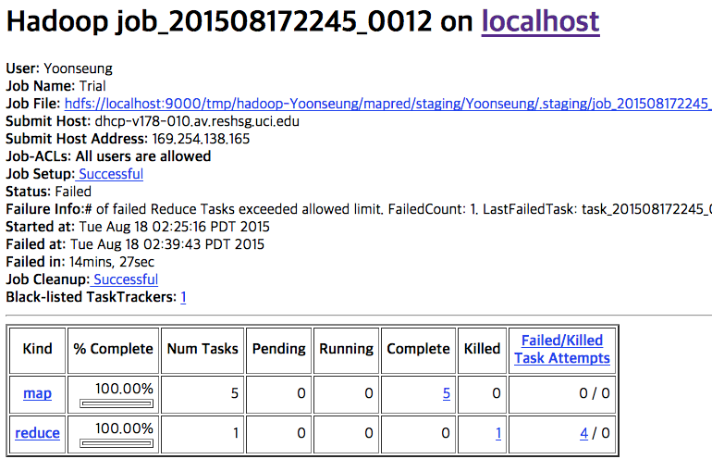
Configuration was:
1.3GB Input, 256MB Split size, 1024MB Java Heap Space
Error: Java heap space

Slide 23
Summary of Solution
Modify the Configuration parameters
Alter the program’s algorithm : Some alternative solution was suggested from the site -> Succeed with original version failed Configuration ( 256MB Split size & 1024MB Java heap size )
Java Heap size |  | 1024MB | 2048MB
Split size | 128 MB | Succeed | succeed
 | 256 MB | Failed | Succeed

Slide 24
Conclusion
Efficient way to process Big data
Adjust ‘split size’ - the more ‘split size’, the less time to spend
Adjust ‘map task capacity’ - suitable for input file size - Big size of map task capacity is not always right
Can measure the size of intermediate data structure, and found some solutions for OOM cases

Slide 25
References
[1] Jeffrey Dean and Sanjay Ghemawat. (2004). “MapReduce: Simplified Data Processing on Large Clusters”. [Online]. Available: http://static.googleusercontent.com/media/research.google.com/ko//archive/mapreduce-osdi04.pdf
[2] 한기용, Do it! 직접 해보는 하둡 프로그래밍. Seoul: EasysPublishing, 2013.
[3] Lijie Xu, “An Empirical study on real-world OOM cases in MapReduce jobs, Chinese Academy of Sciences.
[4] Donald Miner and Adam Shook, MapReduce Design Patterns. O’Reilly Media. Inc, 2012.

Slide 26
Thank You
And if you want to know more technical information, please enter our GitHub repository.
https://github.com/I-SURF-Hadoop/MapReduce

Slide 27
appendix
How does MapReduce really work?

Slide 28
How does MapReduce work?
The cat sees the dog, and the dog sees the cat.
The cat sees the dog
the, 1
Combining & Sorting
[ Map Phase ]
cat, 1
cat, 1
MapReduce library first splits the input into M pieces.
A map worker processes these pieces using a user-defined Map function. Intermediate key/value pairs will be produced by this function.
sees, 1
dog, 1
the, 1
sees, 1
dog, 1
the, 2

Slide 29
How does MapReduce work?
The cat sees the dog, and the dog sees the cat.
cat, 1
Shuffling
[ Reduce Phase ]
dog, 1
and, 1
sees, 1
When a reduce worker has read all intermediate data, it sorts them by the intermediate keys.
The reduce worker iterates the sorted intermediate data and for each unique intermediate key encountered, it passes the key and the values to the user’s Reduce function.
cat, 2
the, 2
dog, 2
and, 1
sees, 2
cat, 1
the, 4
dog, 1
sees, 1
the, 2
Two independent reducer

